Slide 1

Regression
Teoh Teik Toe
ITOM/NBS
ttteoh@ntu.edu.sg
97905202

Slide 2
Reading before class
https://www.youtube.com/watch?v=zPG4NjIkCjc
https://www.youtube.com/watch?v=HjkR9KzhKN4
Drive:
Code: https://drive.google.com/drive/folders/1fXjR7HWQVDvW4b_UwFmEM_NymlOo4Wbw?usp=sharing
Data: https://drive.google.com/drive/folders/1DWSSkL9zMwXktar8rxC_3rUGqxwNNTrR?usp=sharing

Slide 3
Agenda
Regression Theory
What is regression and the metrics
Types of regression
Application & Interview Questions
Advantages & Disadvantages & Limitation
Programming of Regression
Examples
DBS (Regression)
Bankruptcy Data (Classification)
Treynor (Regression)

Slide 4
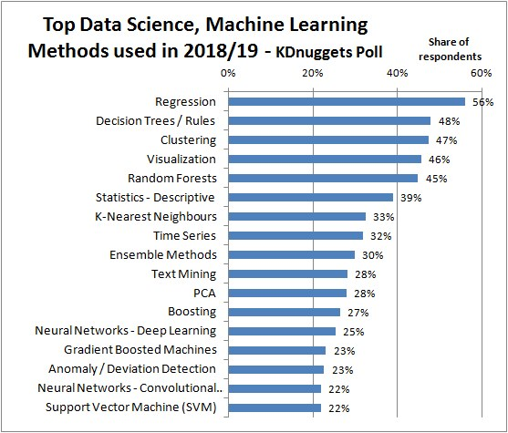
https://images.app.goo.gl/RZL5fApQc5t4syyr5

Slide 5
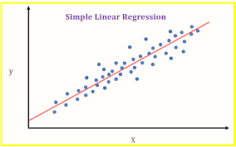
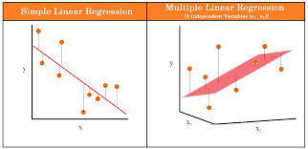
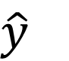
Linear Regression Model Line
Coefficient – Try and Error (Brute Force)
$y=b_{0}+{b_{1}x}_{1}+b_{2}x_{2}+…+b_{m}x_{m}+e$
$\hat{y}$
Must be normally distributed
Use QQ Plot test

Slide 6
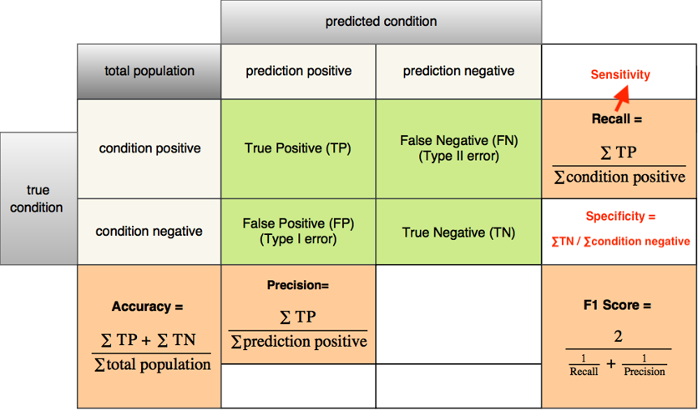
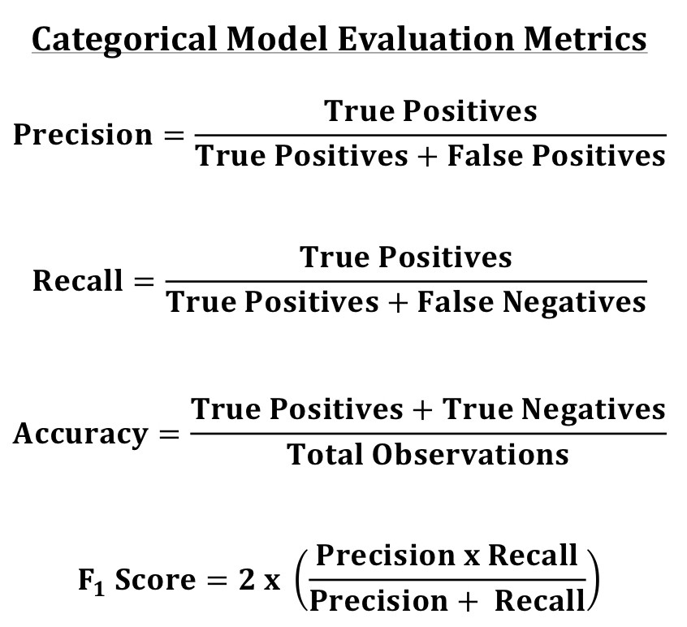
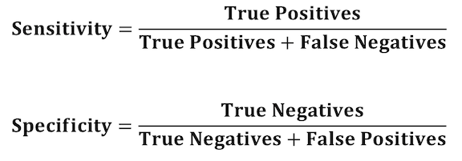
Categorical - Metrics

Slide 7
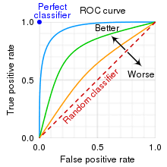
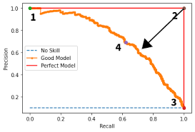
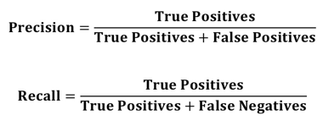
Metrics (Graph)
from sklearn.metrics import plot_roc_curve
plot_roc_curve(model,X_test,Y_test)
from sklearn.metrics import plot_precision_recall_curve
plot_precision_recall_curve(model,X_test,Y_test)
When you force the false negative to go down, the speed of increasing false positive?? All else being equal, hence we are looking at only False Positive vs False False Negatives

Slide 8

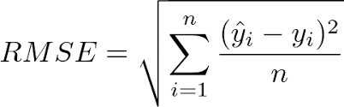
Continuous metrics - RMSE
5 types of error:
Error
Square Error
Sum of Square Error
Mean Square Error
Root Mean Square Error

Slide 9
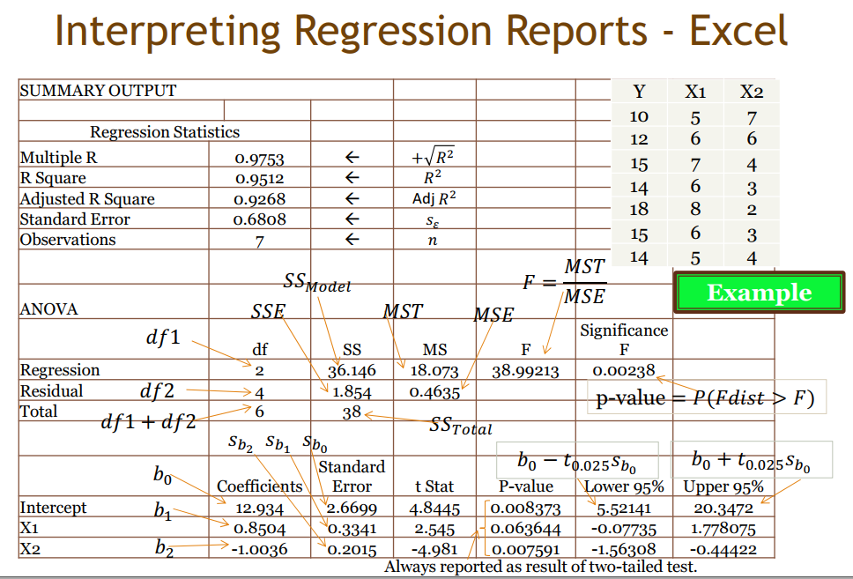
ANOVA Table
R test
F test t test

Slide 10
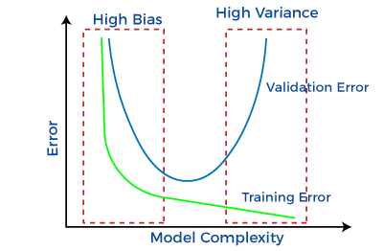
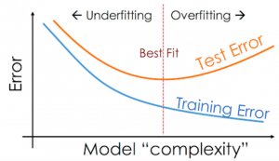
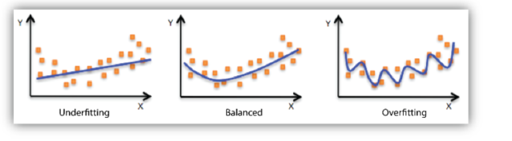
Underfitting vs Overfitting
Bias is the simplifying assumptions made by the model to make the target function easier to approximate. Variance is the amount that the estimate of the target function will change given different training data.
https://youtu.be/7XvBwQeT9OI?si=_t7SUMTOwWyGa620

Slide 11
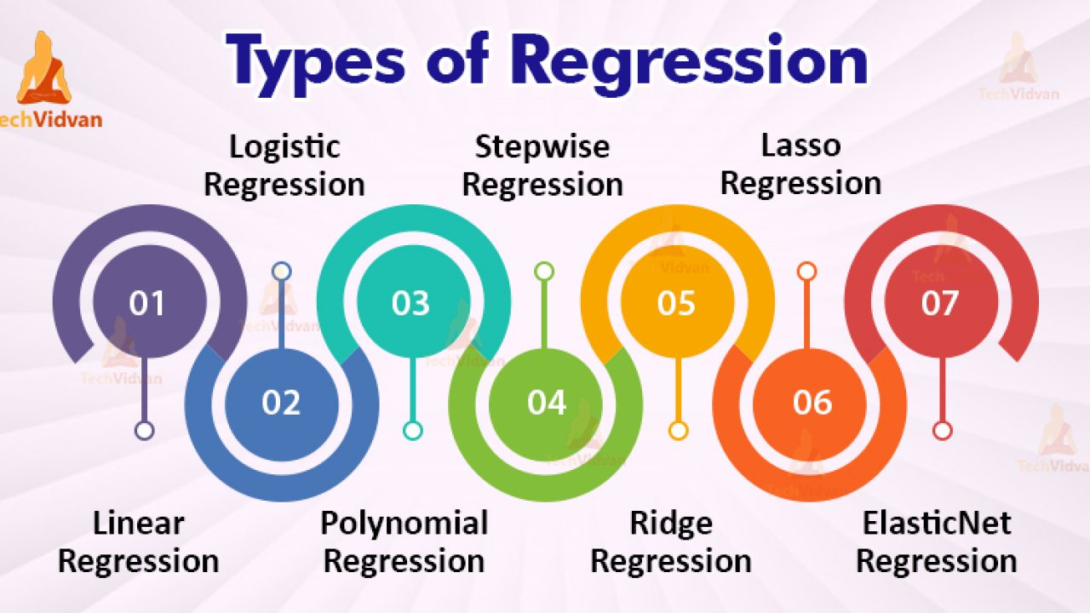
Types of Regression
https://www.youtube.com/watch?v=_3xMSbIde2I
https://www.youtube.com/watch?v=ctmNq7FgbvI

Slide 12
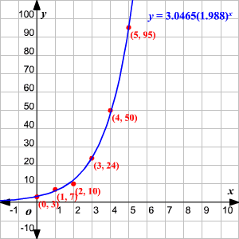

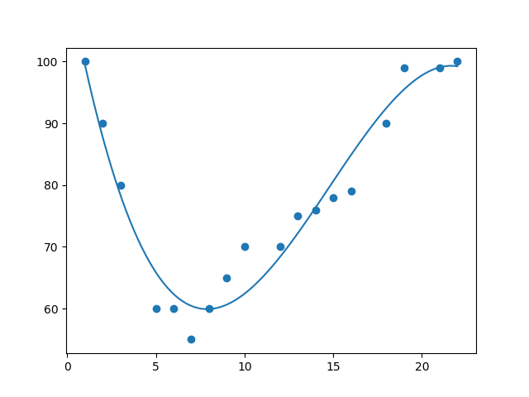
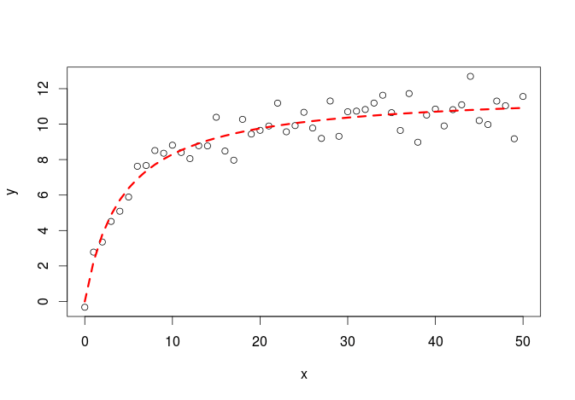
Shape of regression
Linear
Exponential
Polynomial
Logarithm

Slide 13
Application
Supervised Learning (historical labeled data available)
Trend Prediction like
Financial Prediction
Economic Prediction
Pattern Recognition (Business Insights)
Sales
Purchase
Voting Pattern

Slide 14
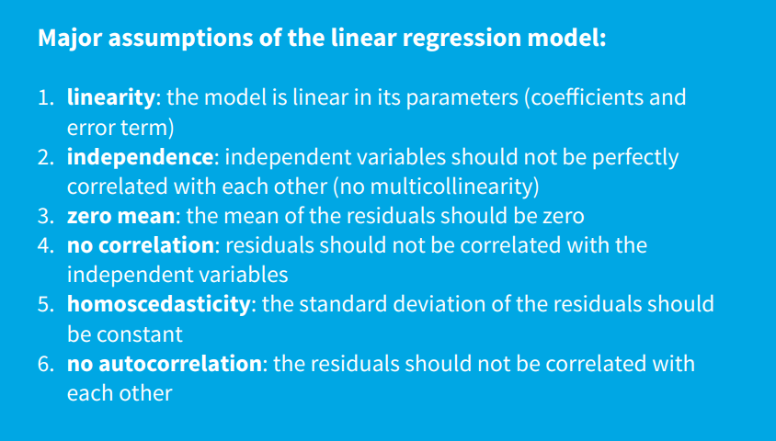
Limitation: Hilpisch Page 34

Slide 15

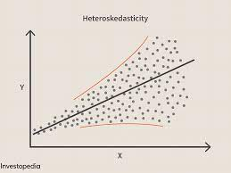
What is heteroscedasticity?
Heteroscedasticity is exactly the opposite of homoscedasticity, which means that the error terms are not equally distributed.

Slide 16
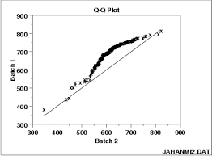
How to interpret a Q-Q plot in a Linear regression model?
A Q-Q plot is used to check the normality of errors. This shows that the errors are mostly normally distributed.

Slide 17
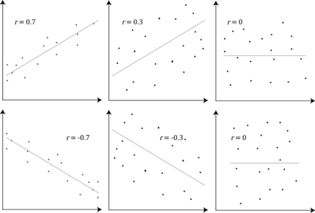
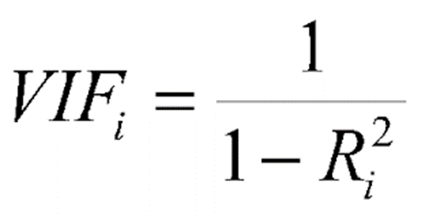
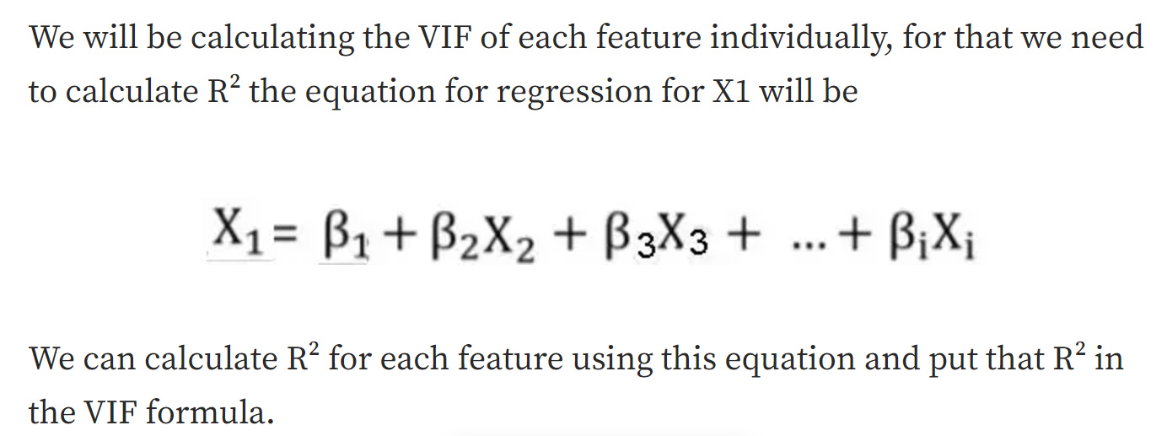
Multi-Collinearity – Check VIF

Slide 18
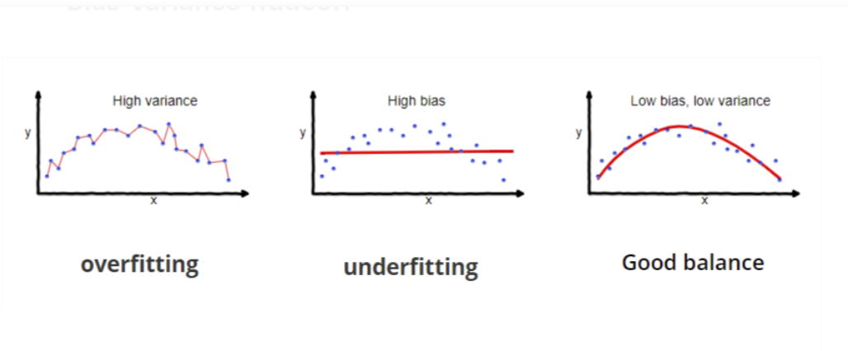
What are the disadvantages of the linear model?
Linear regression is sensitive to outliers which may affect the result.
Under-fitting

Slide 19
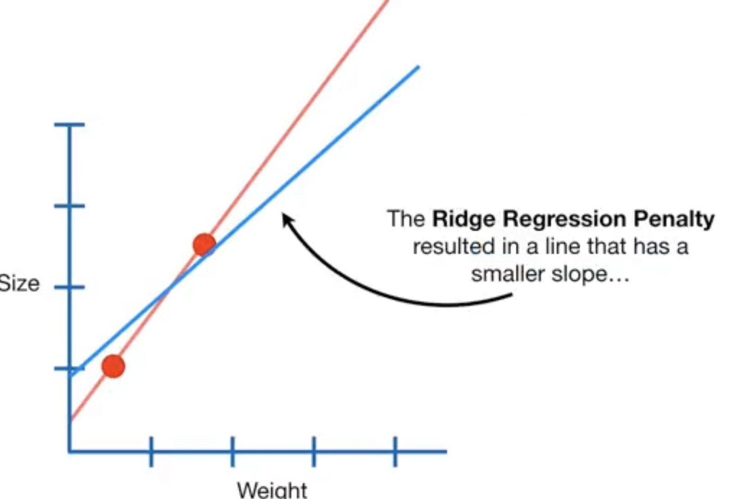
Others
Ridge (reduce the coefficients but NOT to absolute zero)
Lasso regression (make coefficients to absolute zero)
model= linear_model.Ridge()
model.fit(X, Y)
pred=model.predict(X)
print(mean_squared_error(pred, Y)**0.5)

Slide 20
Part II Programming

Slide 21
https://colab.research.google.com/drive/1vELSfdzvbQzj1m5RUDmkx9Wwg9BzpMWw?usp=drive_link
import pandas as pd
from pandas.core.common import random_state
random_state = 1
df = pd.read_csv("/content/drive/MyDrive/TT Library/AI Model/Data/german_credit.csv")
df.isnull().any()
df = pd.get_dummies(df, columns=["Payment Status of Previous Credit", "Purpose", "Most valuable available asset", "Occupation", "Telephone", "Foreign Worker", "Sex and Marital Status",'Account Balance’])
from sklearn.feature_selection import SelectKBest,f_regression
X = df.drop(columns="Creditability")
Y = df["Creditability"]
f = SelectKBest(score_func=f_regression, k=30).fit(X,Y).get_support()
X.columns[f]

Slide 22
Select feature
df = df.loc[:,["Creditability",'Duration of Credit Mths', 'Credit Amount',
'Value of Savings and Stocks', 'Length of current employment',
'Instalment per cent', 'Age', 'Concurrent Credits',
'No of Credits at this Bank', 'Payment Status of Previous Credit_0',
'Payment Status of Previous Credit_1',
'Payment Status of Previous Credit_2',
'Payment Status of Previous Credit_4', 'Purpose_0', 'Purpose_1',
'Purpose_3', 'Purpose_6', 'Purpose_8',
'Most valuable available asset_1', 'Most valuable available asset_4',
'Occupation_4', 'Telephone_2', 'Foreign Worker_1', 'Foreign Worker_2',
'Sex and Marital Status_1', 'Sex and Marital Status_2',
'Sex and Marital Status_3', 'Account Balance_1', 'Account Balance_2',
'Account Balance_3', 'Account Balance_4']]

Slide 23
df.hist(figsize=(50,50))
import seaborn as sns
sns.heatmap(df.corr())
sns.boxplot(data=df["Credit Amount"])
sns.countplot(df,x="Creditability")
sns.catplot(df,x="Creditability",y="Credit Amount", kind="violin")
from imblearn.over_sampling import SMOTE
X = df.drop(columns="Creditability")
Y = df["Creditability"]
from sklearn.model_selection import train_test_split
X_train,X_test,Y_train,Y_test = train_test_split(X,Y,random_state=288)
Y_train.value_counts()
X_train,Y_train = SMOTE(random_state=288).fit_resample(X_train,Y_train)
from scipy import stats
X_train["Credit Amount"] = stats.zscore(X_train["Credit Amount"])
X_test["Credit Amount"] = stats.zscore(X_test["Credit Amount"])
from sklearn import linear_model
from pandas.core.common import random_state
model = linear_model.LogisticRegression(max_iter=2000,random_state=288)

Slide 24
from sklearn import linear_model
from pandas.core.common import random_state
model = linear_model.LogisticRegression(max_iter=2000,random_state=288)
model.fit(X_train,Y_train)
pred = model.predict(X_test)
from sklearn.metrics import confusion_matrix
cm = confusion_matrix(Y_test, pred)
print(cm)
print("Accuracy is ", (cm[0,0]+cm[1,1])/(sum(sum(cm))))
import matplotlib.pyplot as plt
from sklearn.metrics import RocCurveDisplay
RocCurveDisplay.from_predictions(Y_test, pred)
plt.show()
from sklearn.metrics import PrecisionRecallDisplay
PrecisionRecallDisplay.from_predictions(Y_test, pred)
plt.show()

Slide 25
from sklearn import tree
model = tree.DecisionTreeClassifier(random_state=288)
from sklearn import ensemble
model = ensemble.RandomForestClassifier(random_state=288)
fr = model.feature_importances_
print(fr)
for importance, name in sorted(zip(model.feature_importances_,X_train.columns),reverse=True)[:5]:
print (name, importance)
model = ensemble.GradientBoostingClassifier(random_state=288)
from sklearn import neural_network
model = neural_network.MLPClassifier(random_state=288)

Slide 26
Imputation
Check null (imputation?) – May need to check correlation before check null
df.isnull().any() and df["Revenue"].isnull().sum()
If needed, pd.set_option("display.max_rows", 10)
If you have categorical and continuous X, need to do dummy first so that you can use for loop.
#imputation ??
df.isnull().sum()/len(df)
m = df["10Y Net Income Growth (per Share)"].mean()
df["10Y Net Income Growth (per Share)"].fillna(m,inplace=True)
for i in df.columns:
m = df[i].mean()
df[i].fillna(m,inplace=True)
#or using model
pip install miceforest
import miceforest as mf
k = mf.ImputationKernel(df,datasets=1,random_state=1)
k.mice(10) #10 interation
df = k.complete_data(0)
#for categorical
from sklearn.preprocessing import Imputer
imp = Imputer(strategy='most_frequent')
imp.fit(df)
Or
imp = Imputer(strategy=‘constant’,fill_value=“missing)

Slide 27
Feature Selection (PCA)
from sklearn.decomposition import PCA
pca = PCA(n_components=10)
X = pca.fit_transform(X)
Notes:
.

Slide 28
remove outlier
#remove outlier
from sklearn.model_selection import train_test_split df_train,df_test = train_test_split(df)
from scipy import stats
z = abs(stats.zscore(df_train))
df_train = df_train[(z<5).all(axis=1)]

Slide 29
Normalization all features
for i in X_train.columns:
X_train[i] = stats.zscore(X_train[i])
for i in X_test.columns:
X_test[i] = stats.zscore(X_test[i])

Slide 30
Save model and load model
# save the model to disk
Import joblib
joblib.dump(model, 'model name')
# load the model from disk and predict from existing to validate the load
model = joblib.load('model name’)
Print(model.predict([[data]]))

Slide 31
Plot tree
import matplotlib.pyplot as plt
plt.subplots(figsize=(20, 10))
tree.plot_tree(model, fontsize=10)

Slide 32
For Tree - Classifier Optimization
#using grid
from sklearn.model_selection import GridSearchCV
from sklearn import tree
model = tree.DecisionTreeClassifier()
grid = GridSearchCV(estimator = model, param_grid = dict(max_depth = [i for i in range(1, 20)]),cv=10).fit(X_train, Y_train)
grid.best_params_

Slide 33
For Regression - VIF
#vif to check collinearity
#1 = not correlated.
#Between 1 and 5 = moderately correlated.
#Greater than 5 = highly correlated.
from statsmodels.stats.outliers_influence import variance_inflation_factor
vif_data = pd.DataFrame()
vif_data["feature"] = X.columns
vif_data["VIF"] = [variance_inflation_factor(X.values, i) for i in range(len(X.columns))]
print(vif_data)

Slide 34
For Regression – QQ, Anova
QQ plot (check Heteroscedasticity)
import statsmodels.api as sm
from matplotlib import pyplot as plt
mod_fit = sm.OLS(Y,X).fit()
res = mod_fit.resid # residuals
fig = sm.qqplot(res)
plt.show()
Anova (check significant)
from statsmodels.formula.api import ols
from statsmodels.stats.anova import anova_lm
model = ols("Y ~ X", df).fit()
print(model.summary())
anova_results = anova_lm(model)
print('\nANOVA results')
print(anova_results)

Slide 35
What have you learnt?
Regression as Prediction
Types of Regression
Other consideration

